Slide 1
ASSIGNMENT 10
Use the UP and DOWN tags as provided and query the LINCS. These are the KRAS-DEP (UP) and KRAS-IND (DOWN) gene signatures from Singh et al.
We are interested in finding compounds that can inhibit KRAS-DEP cell lines. Look for compounds that is enriched in the “Negative Score”. Select a targeted small molecule from the “Negative Score” (See HINT 1).
Go to Genomics of Drug Sensitivity in Cancer (GDSC) website and download the drug sensitivity data for the compound identified in 2 (See HINT 2).
Use IC50 < 1μM as the cut-off for drug sensitivity.
Run GSEA for the Lung Cancer Cell Lines to find out which pathways are enriched in the Sensitive and Resistant to this ALK inhibitor.
From the GDSC database, find another ALK inhibitor (X). What compound (X) is that?
Download the drug sensitivity data for that ALK inhibitor (X), and use the same IC50 < 5μM cut-off to classify them as sensitive and resistant lines.
Run GSEA for the Lung Cancer Cell Lines based on the sensitive and resistant of this ALK inhibitor (X).
Compare the Pathways that are enriched in both ALK inhibitors in the Sensitive group (list out the common).
Compare the Pathways that are enriched in both ALK inhibitors in the Resistant group (list out the common).
Send me the results of common pathways enriched in the sensitive and resistant group common in both ALK inhibitors.

Slide 2
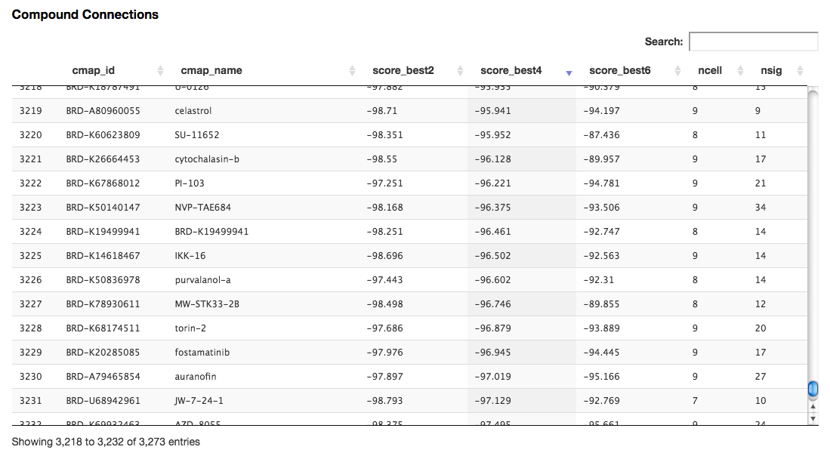
HINT 1: From LINCS

Slide 3
HINT 2: From GDSC http://www.cancerrxgene.org/

